Slide 1
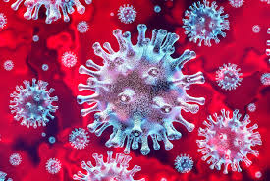
Disease Prediction Project
-Shivam Vatshayan
(Software Engineer)

Slide 2
CONTENTS
DISEASES
MACHINE LEARNING
SCIKIT LEARNING
DATASETS
INPUT
OUTPUT

Slide 3
DISEASES
A disease is a particular abnormal condition that negatively affects the structure or function of all or part of an organism, and that is not due to any immediate external injury. Diseases are often known to be medical conditions that are associated with specific signs and symptoms.

Slide 4
MAchine LEARNING
Machine learning is a method of data analysis that automates analytical model building. It is a branch of artificial intelligence based on the idea that systems can learn from data, identify patterns and make decisions with minimal human intervention.
TWO TYPES :
SUPERVISED LEARNING
UN-SUPERVISED LEARNING

Slide 5
SCIKIT LEARNING
Scikit-learn (Sklearn) is the most useful and robust library for machine learning in Python. It provides a selection of efficient tools for machine learning and statistical modeling including classification, regression, clustering and dimensionality reduction via a consistent interface in Python.

Slide 6
DATASETS
DATASETS CONTAIN MORE THAN 4000 types of diseases !
Datasets Divided into 2 parts:
Testing
Training

Slide 7
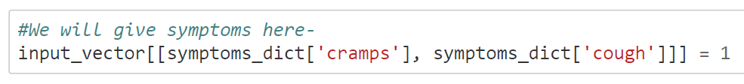
INPUT

Slide 8
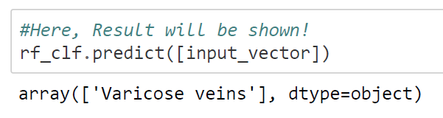
OUTPUT

Slide 9
HI, there :)
-Projects is Research paper based
-Python Programming
-Mail me at vatshayan007@gmail.com to get Project Code, Project synopsis, PPT & Research paper of this Project.
-Shivam Vatshayan
(Software Engineer)

